Slide 1

Data Mining (Metric)
Data Mining
Dr. Sajarwo Anggai, S.ST., M.T. NIDN : 0421108703

Slide 2
Model Evaluation (Evaluasi Model)
Area under ROC is the area under the receiver-operating curve.
Classification accuracy is the proportion of correctly classified examples.
F-1 is a weighted harmonic mean of precision and recall (see below).
Precision is the proportion of true positives among instances classified as positive, e.g. the proportion of Iris virginica correctly identified as Iris virginica.
Recall is the proportion of true positives among all positive instances in the data, e.g. the number of sick among all diagnosed as sick.
Specificity is the proportion of true negatives among all negative instances, e.g. the number of non-sick among all diagnosed as non-sick.
LogLoss or cross-entropy loss takes into account the uncertainty of your prediction based on how much it varies from the actual label.
Matthews correlation coefficient takes into account true and false positives and negatives and is generally regarded as a balanced measure which can be used even if the classes are of very different sizes.
https://orangedatamining.com/widget-catalog/evaluate/testandscore/

Slide 3
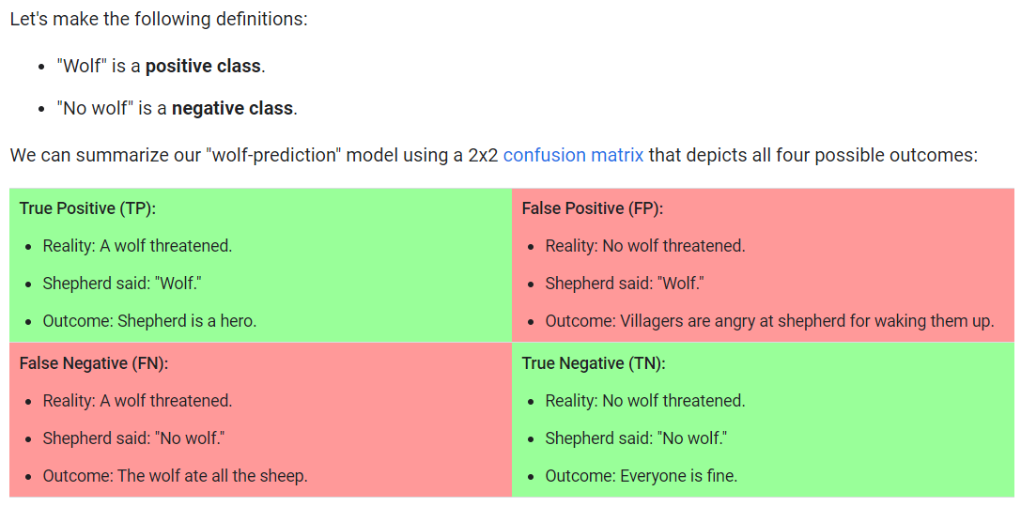
Confusion Matrix
A true positive is an outcome where the model correctly predicts the positive class. Similarly, a true negative is an outcome where the model correctly predicts the negative class.
A false positive is an outcome where the model incorrectly predicts the positive class. And a false negative is an outcome where the model incorrectly predicts the negative class.
https://developers.google.com/machine-learning/crash-course/classification/true-false-positive-negative

Slide 4
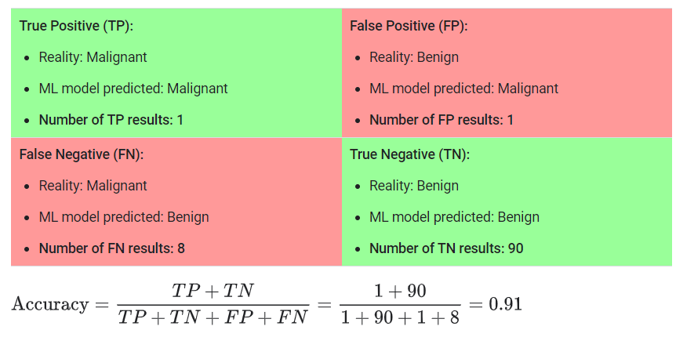


Accuracy
https://developers.google.com/machine-learning/crash-course/classification/accuracy

Slide 5
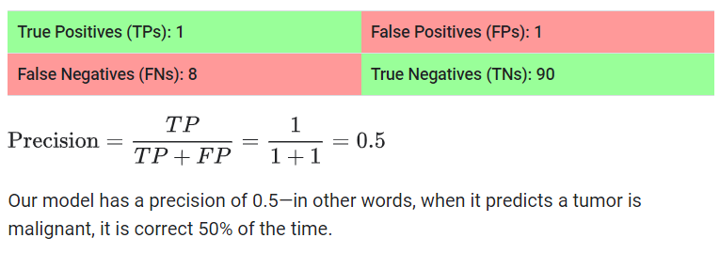
Precision and Recall
What proportion of positive identifications was actually correct?
https://developers.google.com/machine-learning/crash-course/classification/precision-and-recall

Slide 6
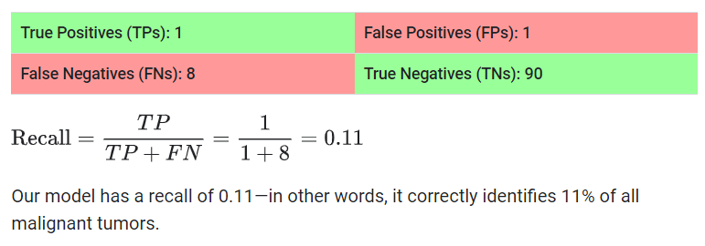
Precision and Recall
What proportion of actual positives was identified correctly?
https://developers.google.com/machine-learning/crash-course/classification/precision-and-recall

Slide 7
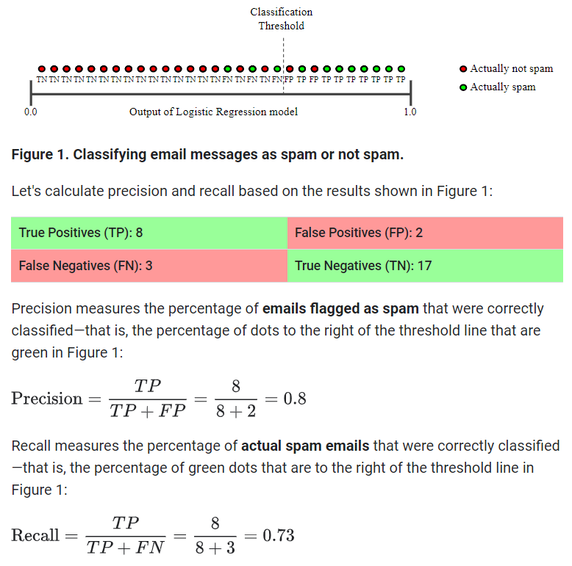
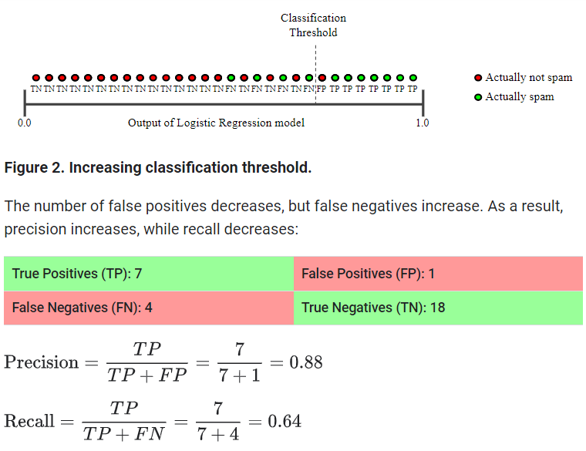
Precision and Recall
https://developers.google.com/machine-learning/crash-course/classification/precision-and-recall

Slide 8
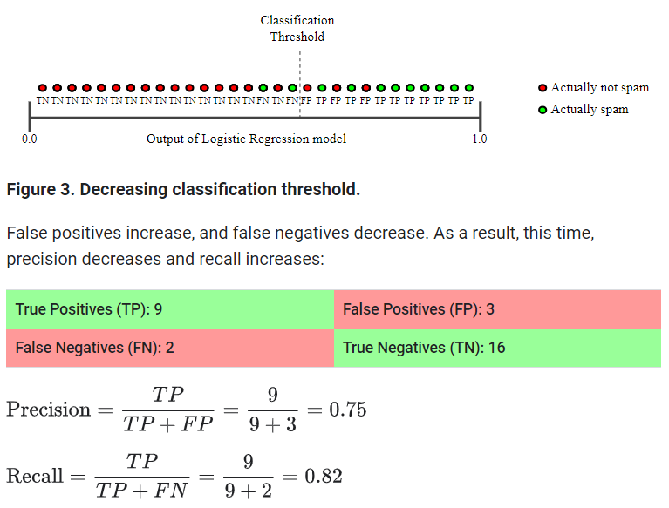
Precision and Recall
https://developers.google.com/machine-learning/crash-course/classification/precision-and-recall

Slide 9
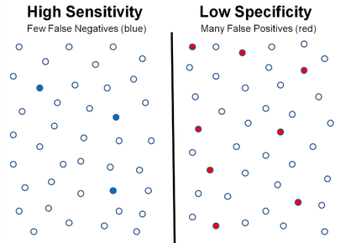


Sensitivity vs Specificity
Sensitivity/Recall mengukur kemampuan model untuk mengidentifikasi semua sampel yang sebenarnya termasuk dalam kelas positif (true positives).
Spesificity mengukur kemampuan model untuk mengidentifikasi semua sampel yang sebenarnya termasuk dalam kelas negatif (true negatives).
https://vitalflux.com/ml-metrics-sensitivity-vs-specificity-difference/

Slide 10
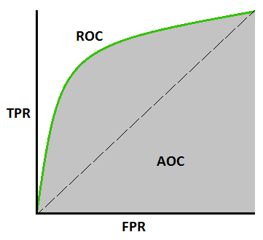
AUROC Curve
AUC (Area Under The Curve) ROC (Receiver Operating Characteristics) curve
ROC is a probability curve and AUC represents the degree or measure of separability. It tells how much the model is capable of distinguishing between classes. Higher the AUC, the better the model is at predicting 0 classes as 0 and 1 classes as 1.

Slide 11
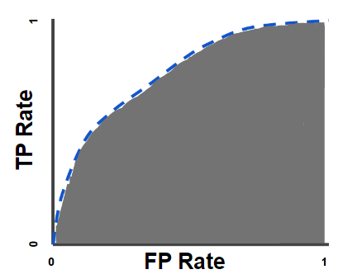


AUROC Curve
AUC (Area Under The Curve) ROC (Receiver Operating Characteristics) curve
True Positive Rate (TPR) is a synonym for recall:
False Positive Rate (FPR) is defined as follows:

Slide 12

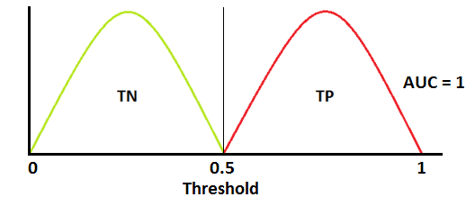

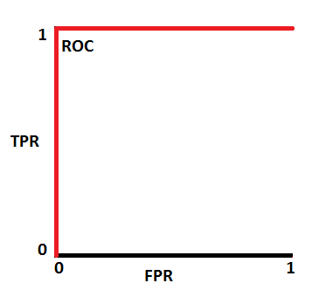
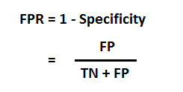
AUROC Curve

Slide 13
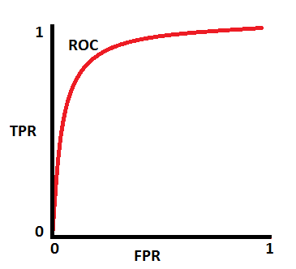
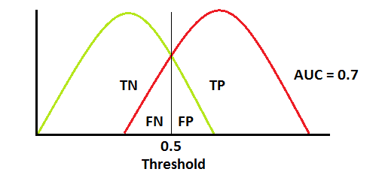
AUROC Curve

Slide 14
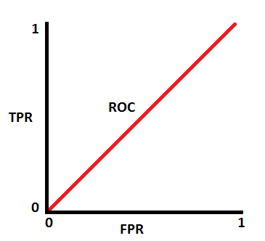
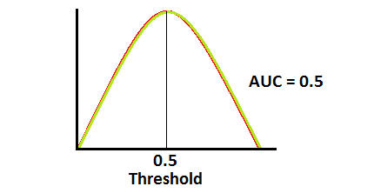
AUROC Curve

Slide 15
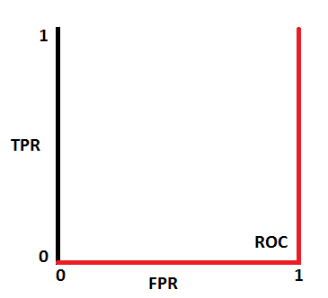
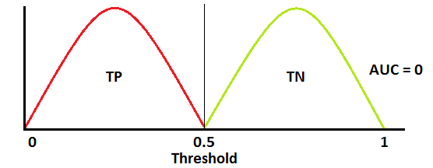
AUROC Curve

Slide 16
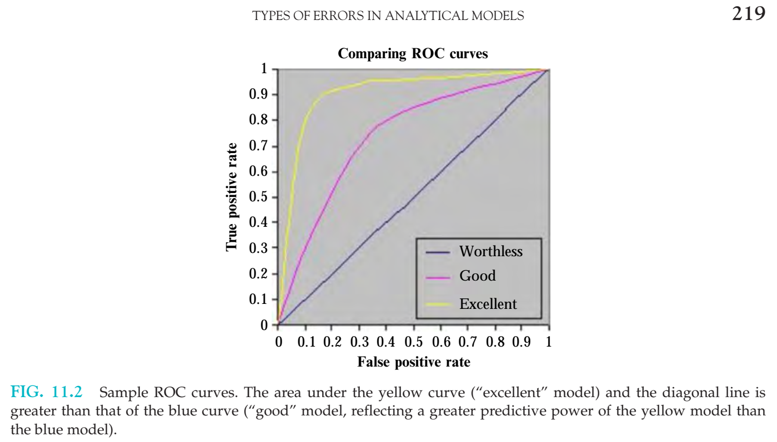

Slide 17

Cross Entropy
Cross Entropy adalah loss function yang banyak digunakan pada tugas klasifikasi. Cross Entropy mengukur perbedaan antara dua distribusi probabilitas untuk variabel acak tertentu atau serangkaian peristiwa.
Cross Entropy digunakan saat menyesuaikan bobot model selama training. Tujuannya adalah untuk meminimalkan loss, yaitu semakin kecil loss semakin baik modelnya. Model yang sempurna memiliki cross-entropy loss 0. Metode ini biasanya berfungsi untuk klasifikasi multi-kelas dan multi-label.
Cross-entropy dapat dihitung menggunakan probabilitas kejadian dari P dan Q, sebagai berikut:
https://www.trivusi.web.id/2022/08/loss-function.html

Slide 18
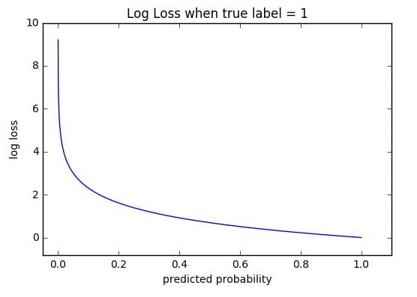

Log Loss
Log Loss, merupakan Binary Cross Entropy. Loss function jenis ini mengukur kinerja model klasifikasi, di mana outputnya adalah probabilitas dengan nilai antara 0 dan 1.
Saat probabilitas yang diprediksi semakin jauh dari label sebenarnya, Log loss akan meningkat. Model yang sempurna akan memiliki Log Loss 0.
https://www.trivusi.web.id/2022/08/loss-function.html

Slide 19
Tugas
Silahkan diskusikan mengenai metrik yang ada
Diskusikan hasil proyek UTS di forum diskusi

Slide 20

Universitas Pamulang
Magister Teknik Informatika
Sajarwo Anggai
Dosen – Universitas Pamulang
NIDN : 0421108703
Email : dosen02832@unpam.ac.id
WA : 082343006557
Terima Kasih

